Slide 1
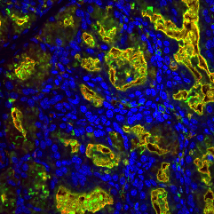
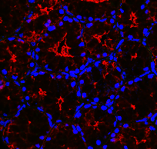
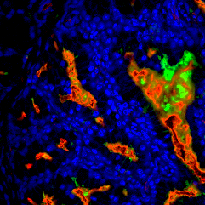
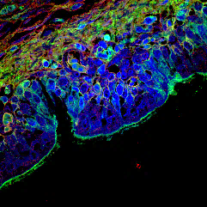
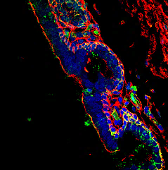
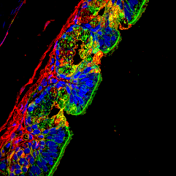
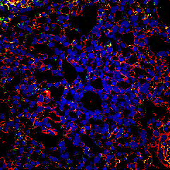
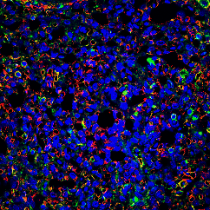
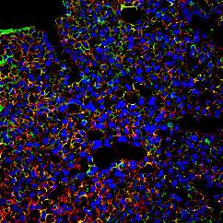
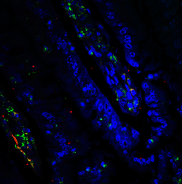
Supplementary Figure 14. Comparison of influenza receptor distribution in the respiratory tract and the duodenum of chickens, ducks, and quails.
a
Chicken
Duck
Quail
e
i
m
q
u
Palate
SNA
MALⅡ
DAPI
MAL Ⅱ
SNA
DAPI
b
f
j
n
r
v
Trachea
c
g
k
o
s
w
Lung
d
h
l
p
t
x
Duodenum

